Slide 1

CCLS LLM Workshop – Agents Section

Slide 2

What is an AI Agent?
An AGENT is an autonomous or semi-autonomous system that perceives its environment and takes actions to achieve goals.
Key Features:
Has a goal or objective
Can take actions
May interact with users or other systems
Uses reasoning to plan steps

Slide 3






Agent Setup
Tools
Memory
Agent
Environment
Knowledge
Output
Fine Tuning

Slide 4
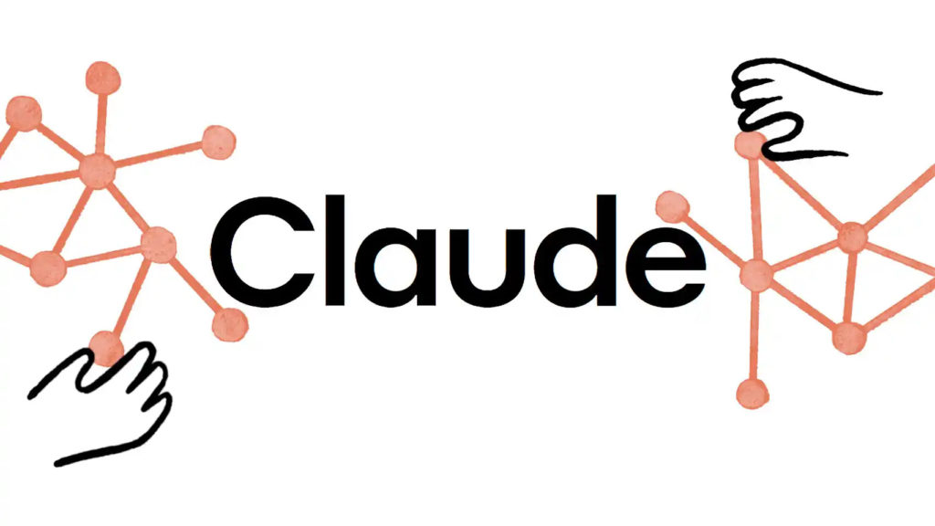
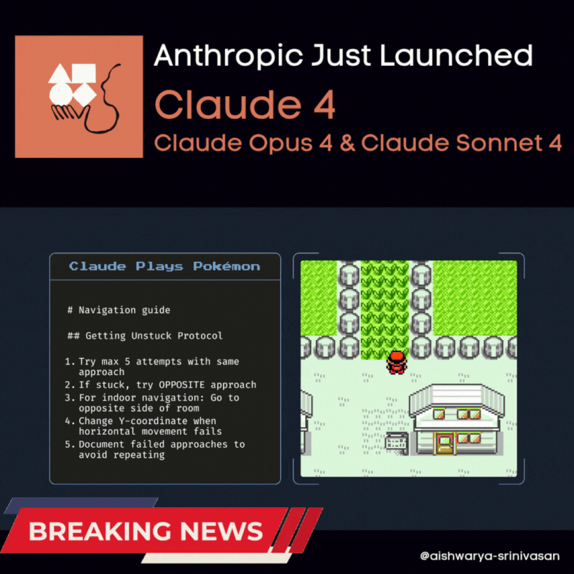

Our Example:
plays
Notes:
https://media.licdn.com/dms/image/v2/D4D22AQFqkH04P2EFzw/feedshare-shrink_800/B4DZb5VnsoHEAg-/0/1747939930605?e=2147483647&v=beta&t=ZiUWe85Z_7Rp3i0nud8pbAGEhYp3fzhvGF4zaeDrpUo

Slide 5
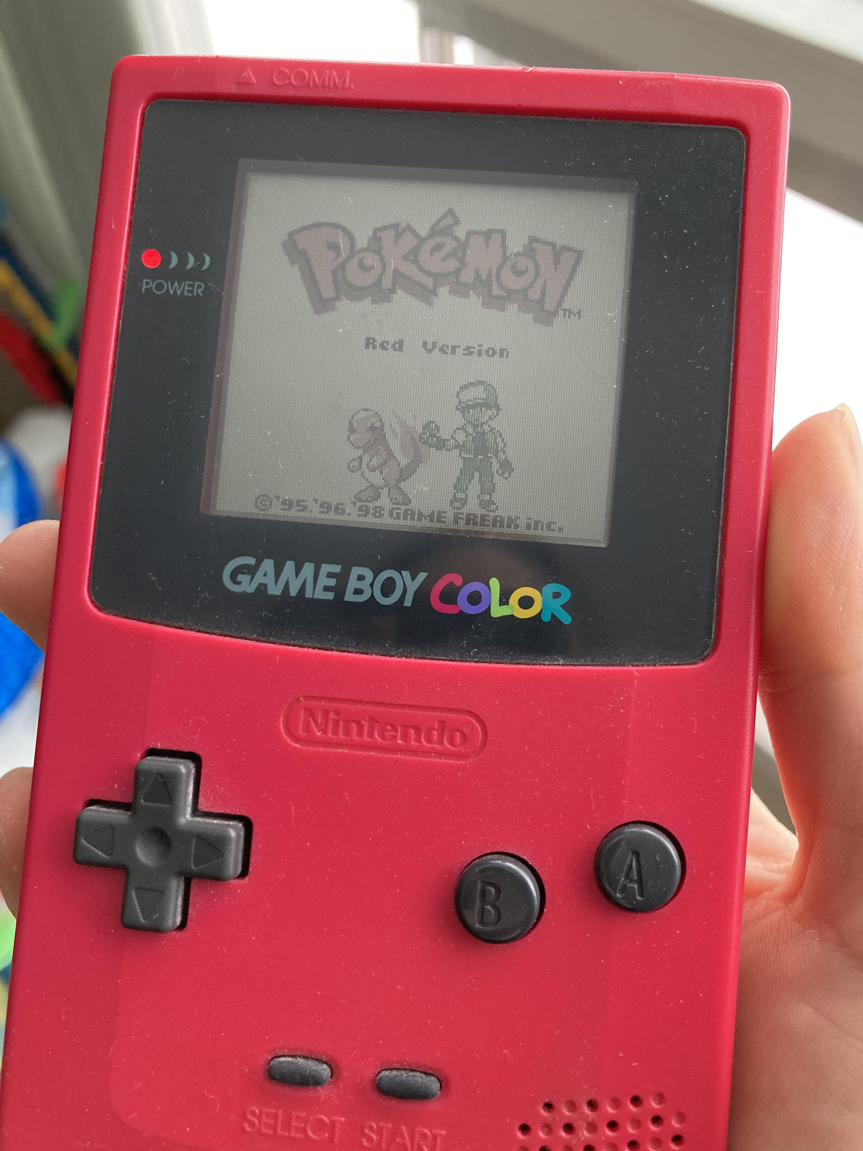
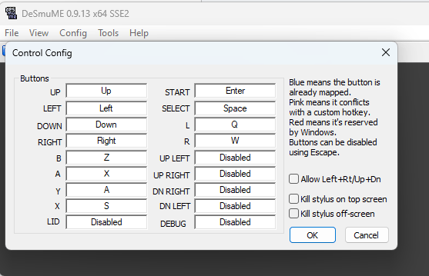
What are ?
Tools
Definition:
Tools are external functions, APIs, or systems the agent can call to perform specific tasks it can’t handle natively.
Examples:
A Python code execution tool for statistical analysis
A medical database query tool
A plotting library (e.g., matplotlib) to visualize trends
Notes:
https://static.pokemoncoders.com/wp-content/uploads/2024/11/how-to-configure-buttons-on-desmume-default-controls.png?strip=all&lossy=1&ssl=1
https://i.redd.it/found-my-old-gameboy-color-still-has-pok%C3%A9mon-red-in-the-v0-jr0jrjvadid81.jpg?width=3024&format=pjpg&auto=webp&s=c363ebb2b44e914e7483550b2600a00322644fd0

Slide 6
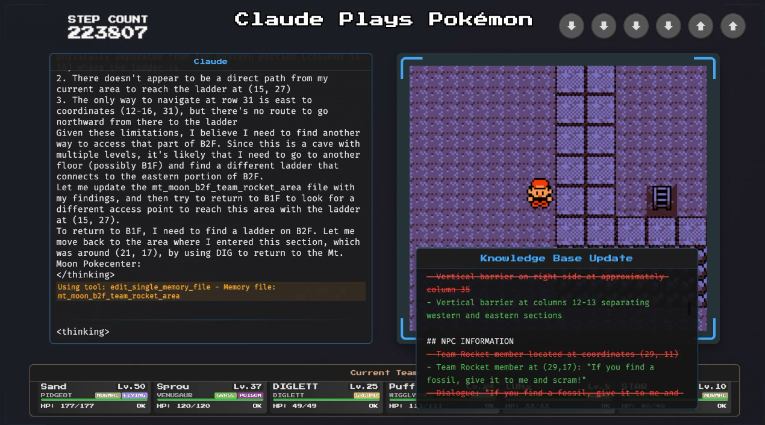
What is the ?
Environment
Definition:
The environment is everything external that the agent perceives and interacts with. It includes users, datasets, APIs, file systems, and tools.
Course Example:
Environment: Kaggle dataset, notebooks, plotting libraries, external clinical databases
Agent Actions: Reads CSV files, generates plots, writes summaries, recommends features

Slide 7
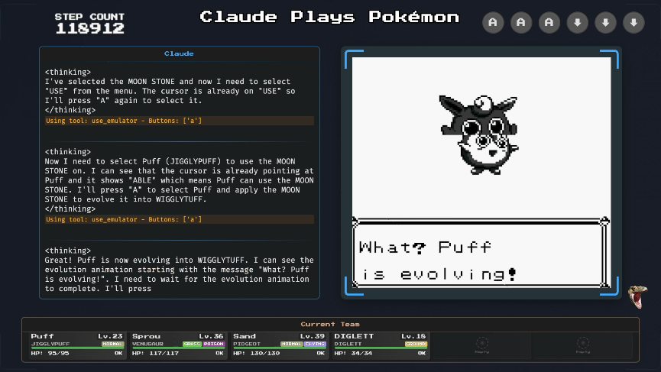
What is the ?
Output
Types of Output:
Text: Descriptive analysis or summaries
Code: Python scripts to process data
JSON: Structured data outputs for pipelines or APIs
Plots: Visual output like bar charts or survival curves

Slide 8

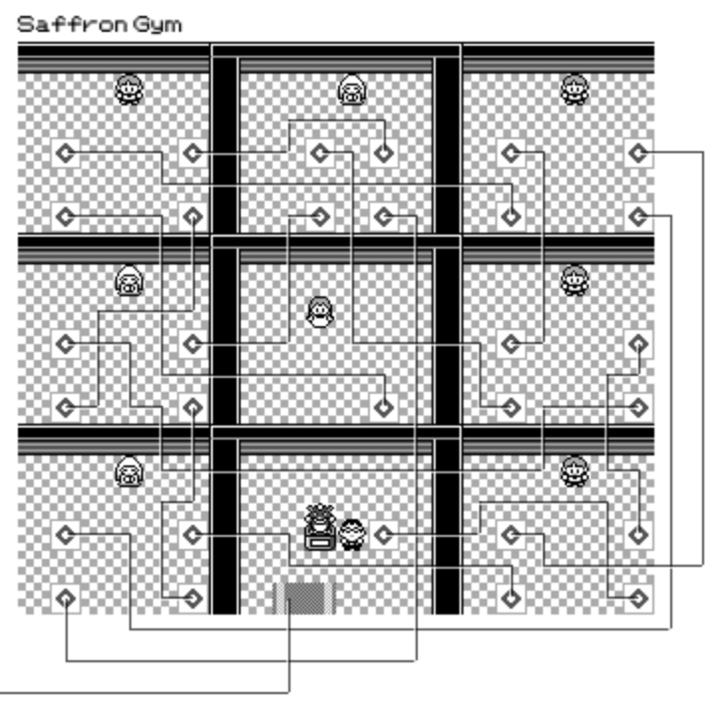
What is ?
Memory
How far did I progress?
Definition:
Memory allows an agent to remember past interactions, decisions, and user inputs across sessions or within a workflow.
Types:
Short-Term Memory: Within a single task
Long-Term Memory: Stored between sessions (e.g., previous patient cases)
Where am I?
Notes:
https://grid-paint.com/images/png/2017/12/01/6585266294751232.png
https://blog.vjeux.com/2023/project/pokemon-red-blue-map.html

Slide 9
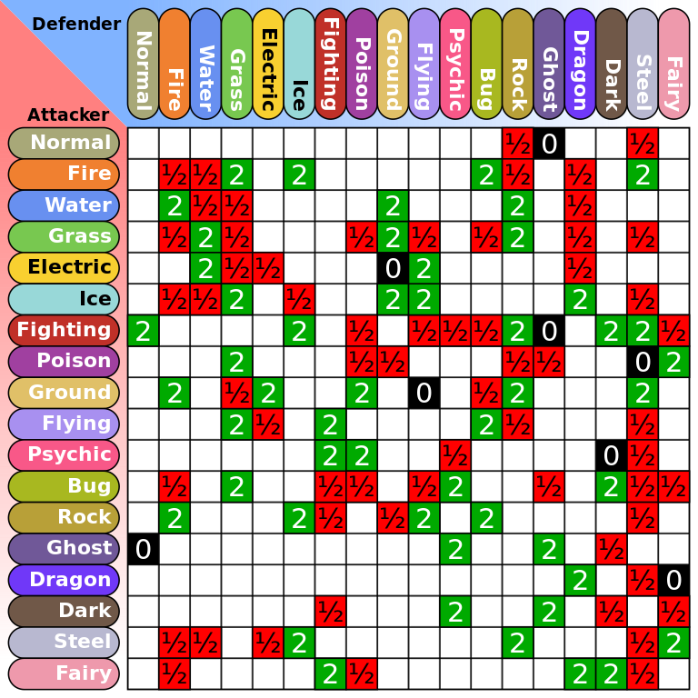
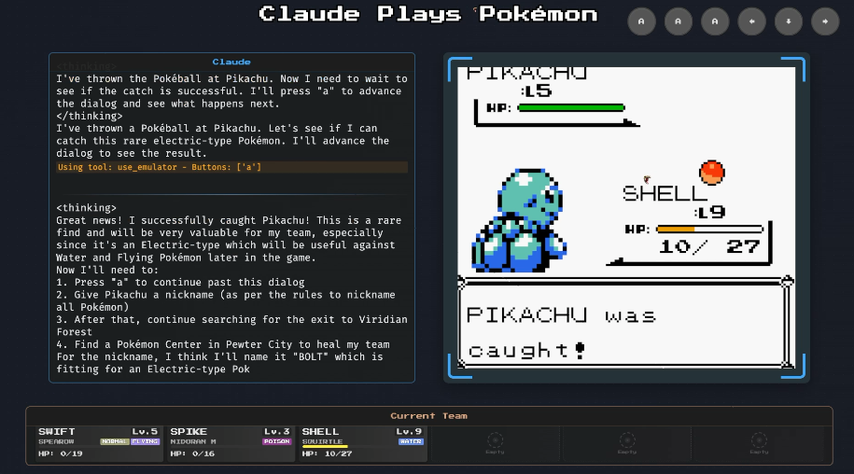
What is ?
Knowledge
Definition:
Knowledge is the information the agent is initialized or trained with—either hardcoded facts or embedded in model weights.
Forms:
Static: Embedded in the model (e.g., general medical knowledge)
Dynamic: Retrieved or updated via tools or databases
Notes:
https://upload.wikimedia.org/wikipedia/commons/thumb/9/97/Pokemon_Type_Chart.svg/768px-Pokemon_Type_Chart.svg.png

Slide 10
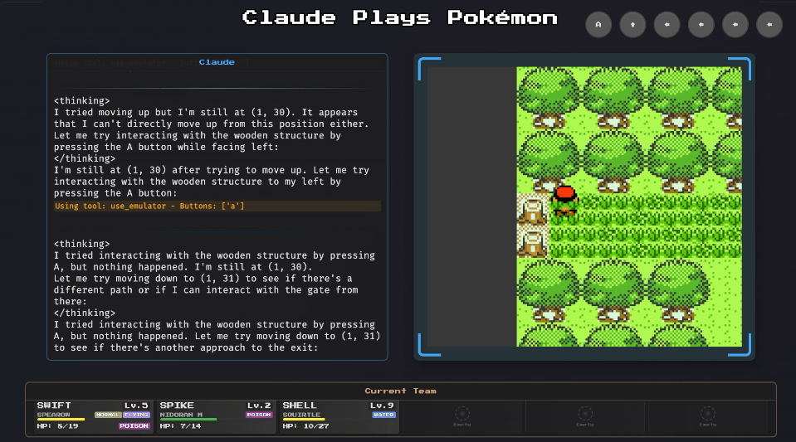
What is ?
Fine Tuning
Definition:
Fine-tuning is the process of training an LLM on a specific dataset to specialize it for a task or domain.
Use Case:
General LLM → Fine-tuned on cardiology literature → Expert medical agent

Slide 11

What is an ?
Agent Teams
Definition:
Agent teams are multiple agents that work together each with specialized roles to solve complex tasks through collaboration and communication.
Key Properties:
Division of labor: Each agent handles a subtask (e.g., data cleaning, modeling, interpretation)
Communication: Agents share intermediate outputs or decisions
Coordination: Tasks are sequenced or parallelized for efficiency
Battle Agent
Screenshot analyzer
Movement Agent

Slide 12

Thanks for listening!
Notes:
https://preview.redd.it/watching-claude-plays-pokemon-stream-lengethed-my-agi-v0-nl2ramc5iqle1.jpeg?auto=webp&s=07a63a6853b5b3417ed1734119ac5d6486c1bb70

Slide 13
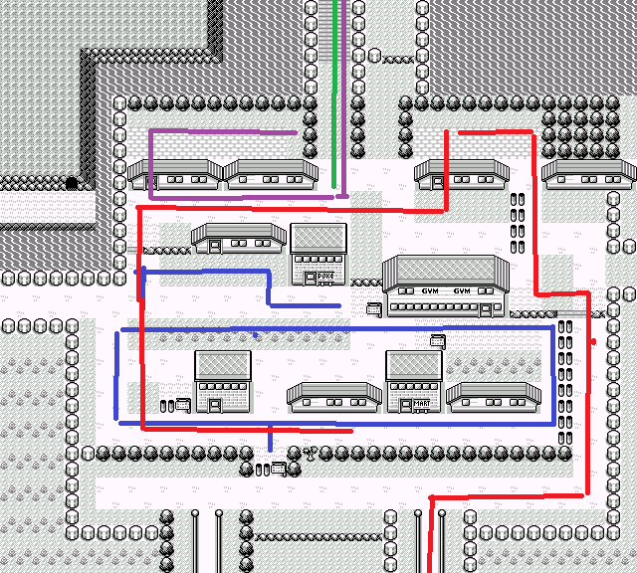
Notes:
https://www.reddit.com/r/ClaudePlaysPokemon/comments/1j31zzq/why_claude_is_stuck_and_why_this_is_actually_a/

